Slide 1


托福听力拔高班1
金牌听力名师
大菁儿老师
2021.6.27

Slide 2

心理学精讲精练：
TPO10 -lecture4 childhood amnesia
cognitive capacity 认知能力
dominant belief
symbolic representation

Slide 3
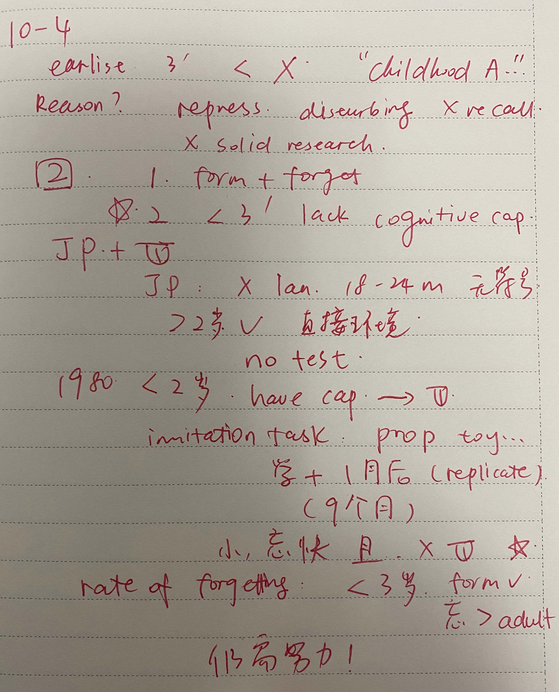
TPO10
lecture4
笔记

Slide 4
TPO10-lecture4
1. What is the main purpose of the lecture?
A. To discuss possible explanations for childhood amnesia
B. To describe key features of childhood amnesia
C. To explain methods of testing memory in children of different ages
D. To discuss why the ability recall memories diminishes as a person ages

Slide 5
TPO10-lecture4
2.Why does the professor ask student about their earliest memories?
A. To help students relate to the topic she is about to discuss
B. To establish that people vary in the time of their earliest memory
C. To introduce the connection between language and memory
D. To point out a common thing in the earliest memories of most people

Slide 6
TPO10-lecture4
3 What does the professor imply about some of the explanations for childhood amnesia that she describes?
A. They can never be proved or disproved.
B. They were formed without proper evidence.
C. They explain only certain types of childhood amnesia.
D. They are contradicted by her own research.

Slide 7
TPO10-lecture4
4 The professor mentions some commonly held explanations for childhood amnesia.Indicate whether each of the following is one of the explanations she mentions.
(1).Early memories are repressed.
(2).Young children have few experiences to remember.
(3).Young children are unable to form memories.
(4).Children lose memories at a faster rate than adults.
(5).Young children do not make an effort to remember events.

Slide 8
TPO10-lecture4
5 How was recall tested in children without language ability?
A. By recording children 's responses to familiar faces.
B. By observing children 's reaction to a repeated series of actions.
C. By having children imitate each other 's actions.
D. By having children imitate an ordered sequence of actions.

Slide 9
TPO10-lecture4
6 The professor mentions a study in the 1980s that tested memory in children under age 3.
What did the researchers conclude from this study?
A. Young children do not develop the capacity for recall until after age 3.
B. Piaget 's theory linking language development to memory was incorrect.
C. Young children typically remember events for about nine months.
D. The formation of memories is dependent upon language development.

Slide 10
托福听力拔高班2
金牌听力名师
大菁儿老师
2021.6.28

Slide 11
History of science 学精讲精练：
TPO21 -lecture1 Geocentric theory
stationary
prevail
astronomical observations
intuitive 直觉的
planetary system 行星系统

Slide 12
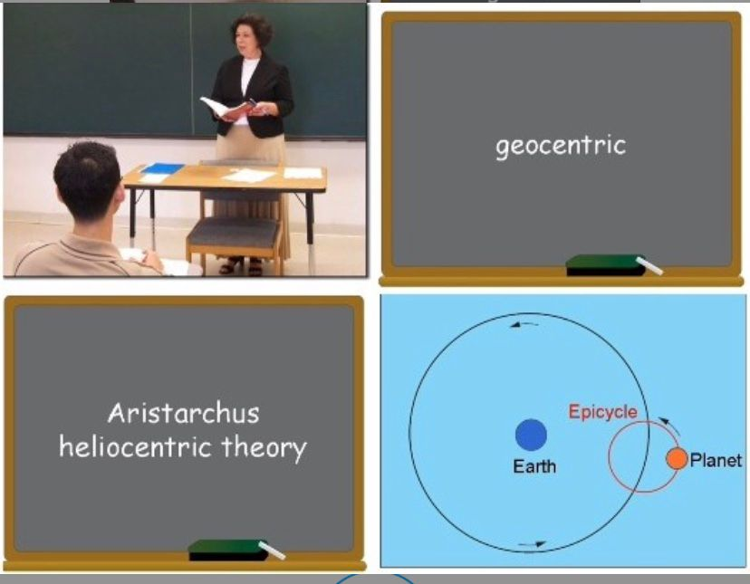
综合练习：
TPO21-L1

Slide 13
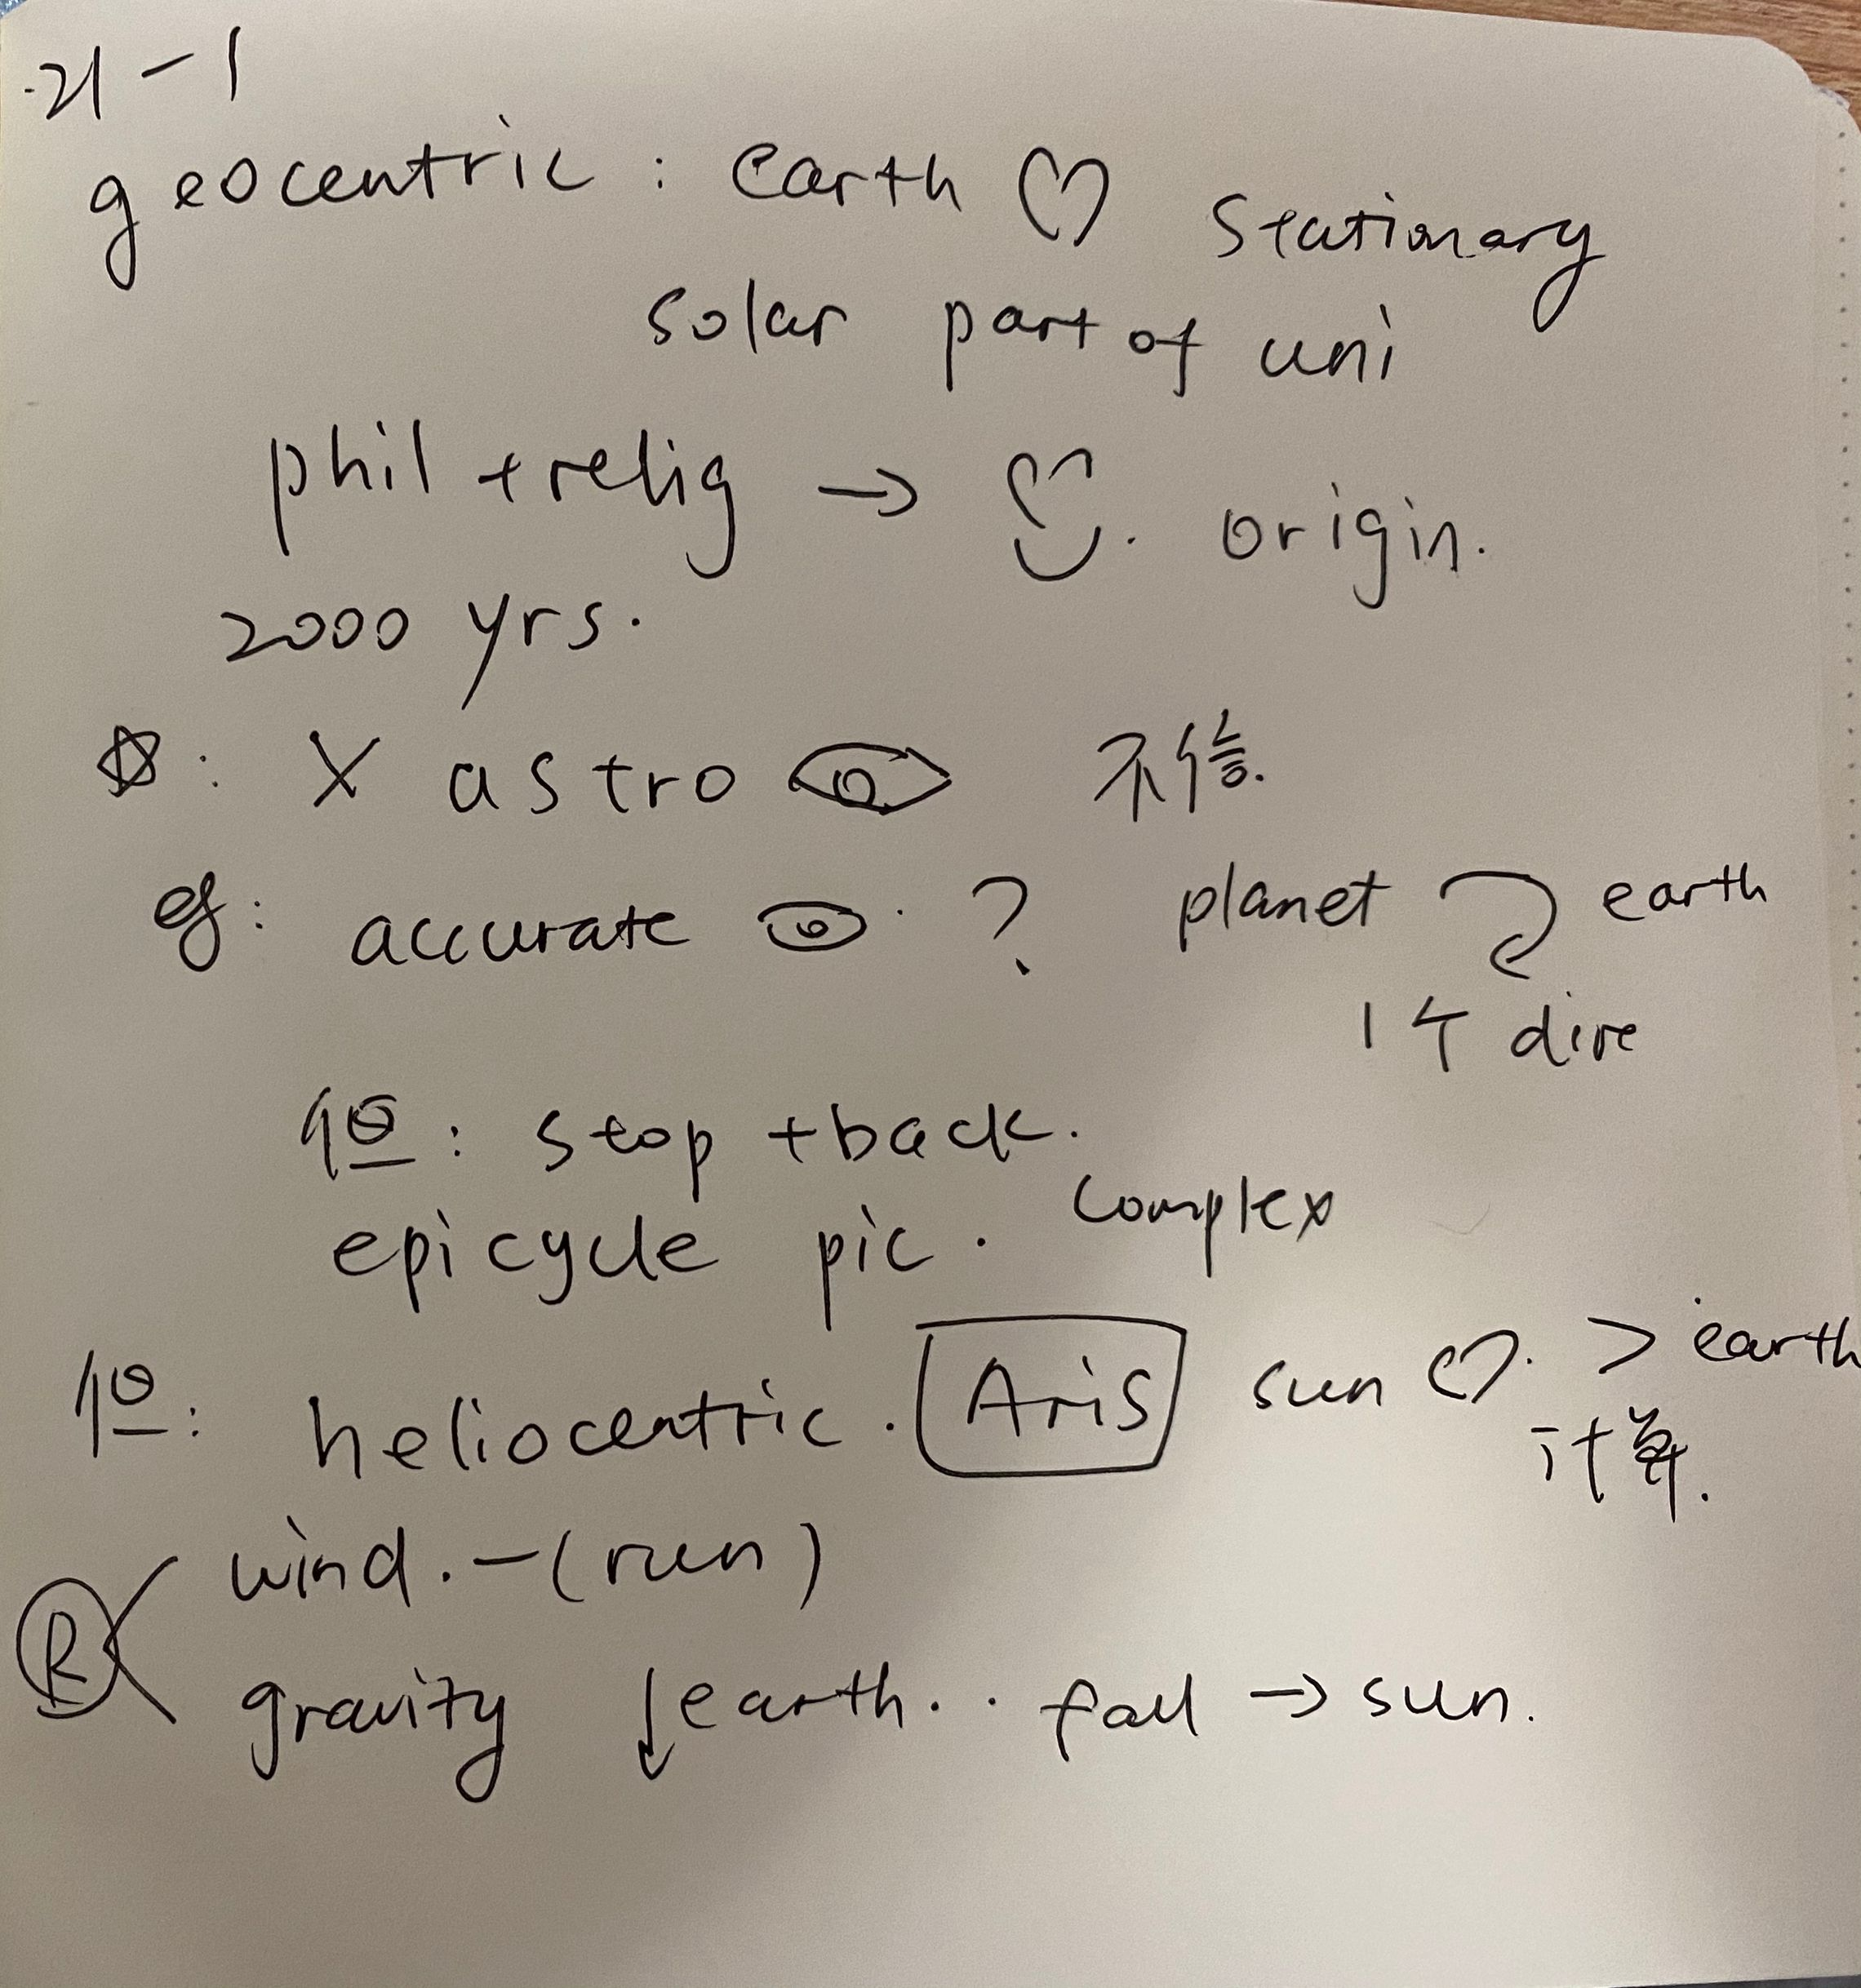
拔高练习：
TPO21-L1

Slide 14
TPO21-lecture1
1. What is the purpose of the lecture?
A. To explain how the heliocentric theory of the universe developed
B. To give an example of the persistence of traditional theories
C. To show that scientific knowledge is rarely influenced by philosophy
D. To compare methods in observational and theoretical astronomy

Slide 15
TPO21-lecture1
2. Why did the ancient Greeks hold geocentric view of the universe?(2 answers).
A. The sun appeared to them to revolve around Earth.
B. They had not developed methods of gathering accurate data on the movement of planets.
C. Their religious and philosophical beliefs supported this view.
D. Some of the planets in the solar system had not been discovered yet.

Slide 16
TPO21-lecture1
3 Why does the professor point out that Greek astronomers tried to explain new astronomical discoveries within the geocentric concept?
A. To explain why early astronomers found new discoveries exciting
B. To explain why some claims made by ancient Greek astronomers conflict with claims made by earlier astronomers
C. To illustrate that the geocentric concept was open to many interpretations
D. To illustrate that the geocentric concept itself was not considered questionable

Slide 17
TPO21-lecture1
4 Why does the professor discuss the epicycle theory?
A. To explain why early astronomers started measuring the velocity of the planets
B. To explain why the astronomer Aristarchus rejected the geocentric model
C. To show how early astronomers explained the apparent backward motion of some planets
D. To show that early astronomers believed that all planets moved in their own orbits around the sun

Slide 18
TPO21-lecture1
5. In the professor's view,what might have caused Aristarchus to propose the heliocentric theory?
A. The discovery that Earth was much smaller than the Sun
B. The lack of proof supporting the theory of epicycles
C. The influence of well-known philosophers
D. The apparent stability of Earth

Slide 19
TPO21-lecture1
6 What were two arguments ancient Greeks used to reject the heliocentric model? [Click on 2 answers.]
A. More stars would be visible in a heliocentric universe.
B. A moving Earth would create a strong wind.
C. Aristarchus's calculations were inaccurate.
D. Objects fall toward the center of the universe.

Slide 20
托福听力拔高班3
金牌听力名师
大菁儿老师
2021.6.29

Slide 21
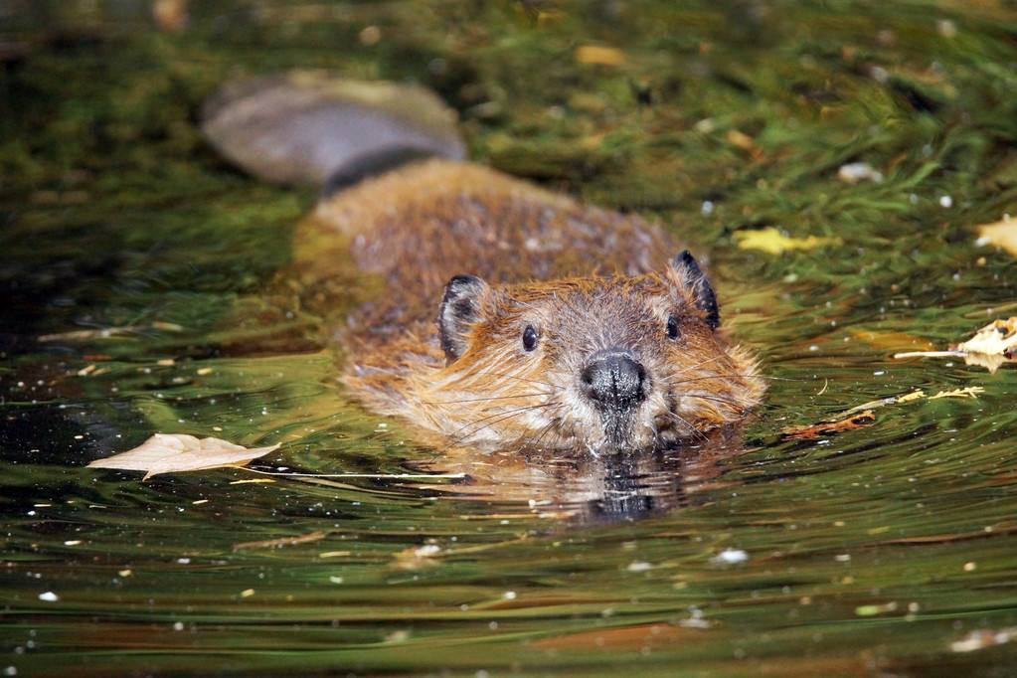
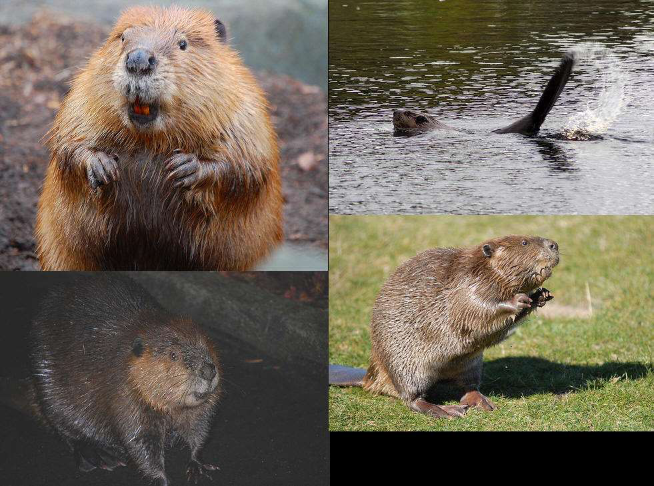
biology学精讲精练： TPO16 -lecture3
Foraging behavior among beavers
natural selection
aspen tree 杨树
ash tree 灰树
presumably 据推测
drag back 拖回

Slide 22
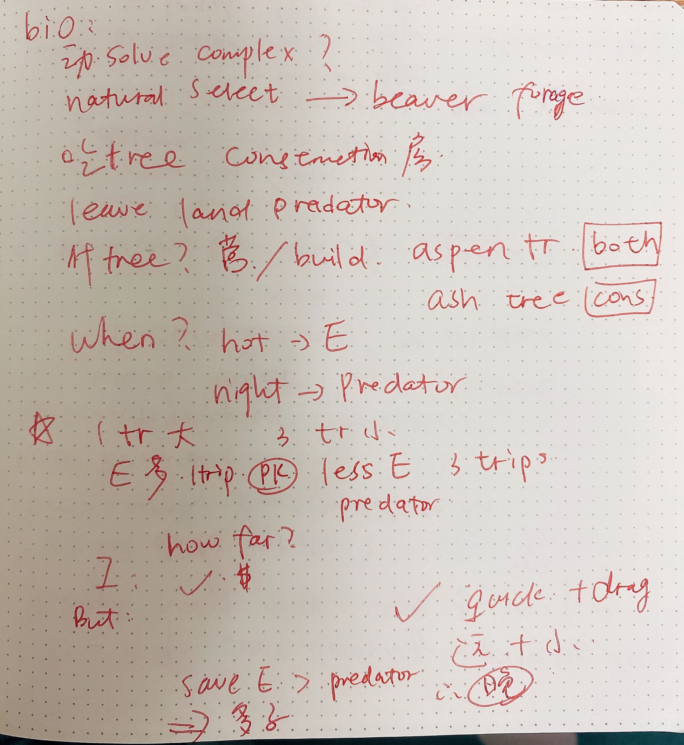
拔高练习：
TPO16-L3

Slide 23
TPO16-lecture3
1. What is the lecture mainly about?
A. Different foraging strategies among animals
B. Methods beavers use to gather building materials
C. Decisions beavers make about where to live
D. Choices beavers face when foraging

Slide 24
TPO16-lecture3
2. What difference between aspen trees and ash trees does the professor point out?
A. Aspen trees are easier to transport.
B. Aspen trees provide better wood for construction.
C. Aspen trees provide less nutrition for beavers.
D. Aspen trees have more overall value to beavers.

Slide 25
TPO16-lecture3
3 What does the professor identify as the two central issues involved in beavers foraging behavior?
[Click on 2 answers.]
A. How far from home to forage
B. How to cope with competition
C. What size tree to cut down
D. What time of year material for construction is available

Slide 26
TPO16-lecture3
4.What does the professor say about the cutting down of large trees?
A. Beavers generally prefer cutting down large trees to small trees.
B. Beavers generally do not travel long distances to cut down large trees.
C. Beavers will not cut down large trees of certain species.
D. Beavers use large trees mainly for the purpose of building shelters.

Slide 27
TPO16-lecture3
5 According to the professor, why do beavers generally forage at night?
A. Beavers are safer from predators if they forage at night.
B. Foraging at night requires less energy than foraging in the daytime.
C. Beavers stay with their offspring during the daytime.
D. Beavers face less competition for food from other animals during the night.

Slide 28
TPO16-lecture3
6 Why does the professor say this:
If you’re going to travel far, make the trip worth it by bringing back the most wood possible.
A. To explain her reasoning.
B. To indicate why her belief was wrong.
C. To give an example of a decision beavers make.
D. To explain the reason beavers travel far for wood.

Slide 29
托福听力拔高班4
金牌听力名师
大菁儿老师
2021.6.30

Slide 30
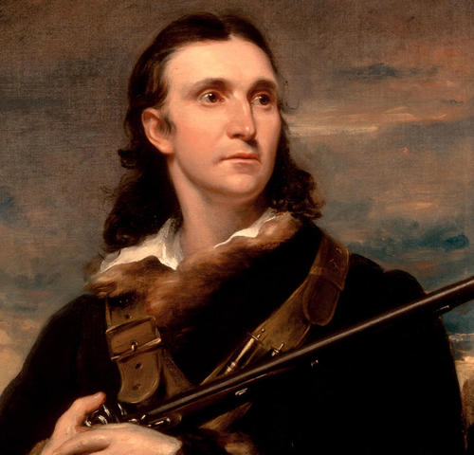
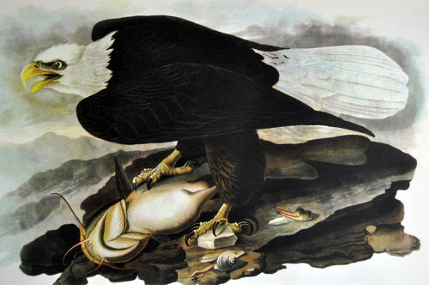
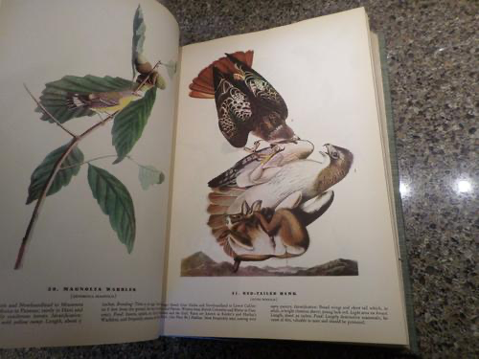
art 精讲精练：
TPO51 -lecture3 Audubon illustrator
dedication 奉献
incredibly meticulous 一丝不苟的
pastel crayons 彩色蜡笔
canvas
preparatory studies
naturalist
migration patterns
in the wild and in captivity
Hybridization

Slide 31
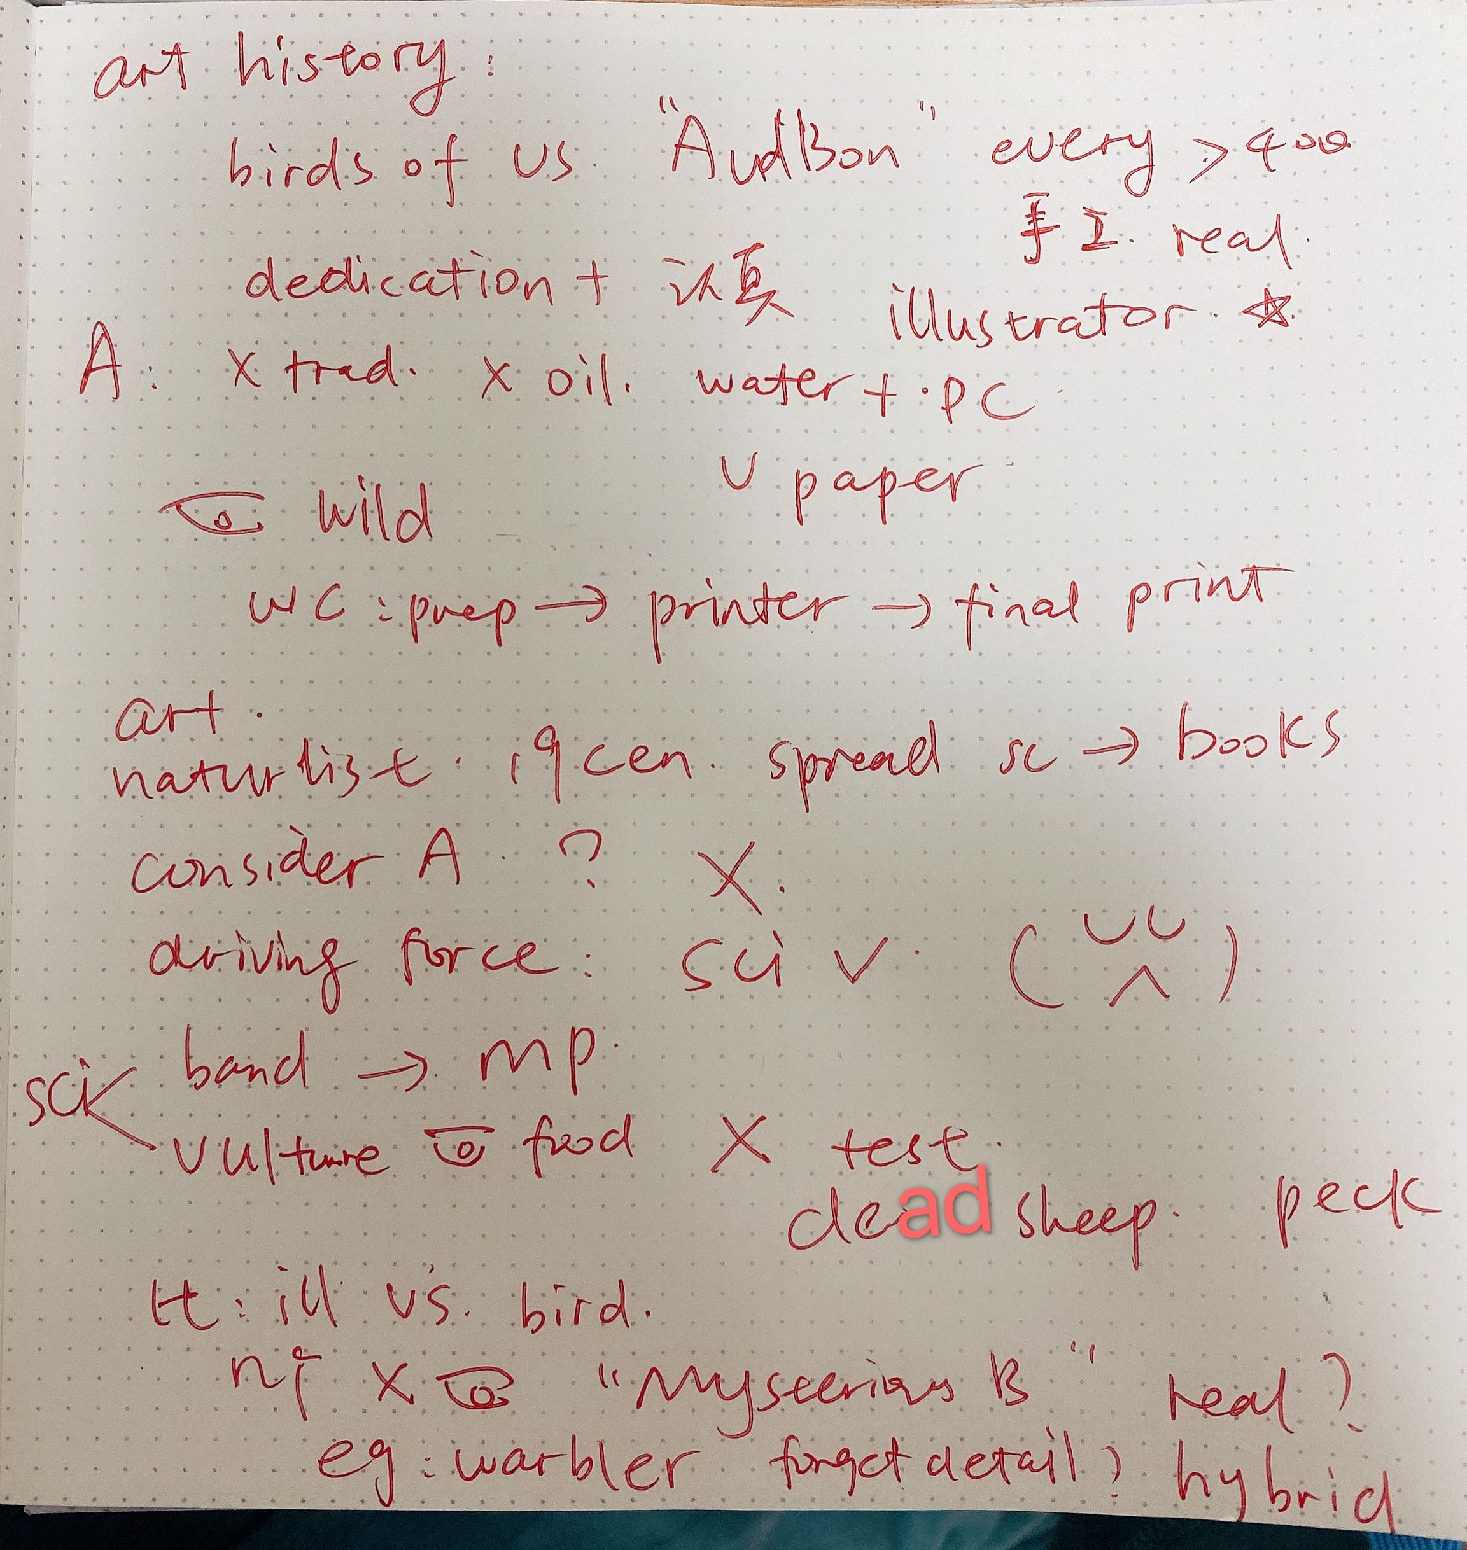
TPO51
lecture3
笔记

Slide 32
TPO51-lecture3
1. What does the professor mainly discuss?
A. The steps involved in publishing illustrated books in the 1800s
B. The influence of Audubon's The Birds of America on science in the 1800s
C. The way in which an illustrator's work has both artistic and scientific significance
D. The need for accuracy in scientific illustrations

Slide 33
TPO51-lecture3
2. According to the professor, what were two steps Audubon took in producing his illustrations?
[Click on 2 answers.]
A. He studied birds in their natural habitats.
B. He tracked birds along their migration paths.
C. He closely studied other illustrated books.
D. He provided the printer with detailed instructions.

Slide 34
TPO51-lecture3
3. What does the professor imply about critics of Audubon's art?
A. They did not recognize the motivating factor in Audubon's art.
B. They did not like the stylistic changes that Audubon developed over time.
C. They were disappointed with Audubon's limited scope of subject matter.
D. They thought Audubon's use of oils was unsophisticated.

Slide 35
TPO51-lecture3
4. Why does the professor discuss Audubon's experiments with vultures and banding birds?
A. To help students understand the state of scientific knowledge at the time
B. To provide support for his view of Audubon as a naturalist
C. To suggest that Audubon was more successful as a scientist than as an illustrator
D. To give examples that show the importance of detail in Audubon's illustrations

Slide 36
TPO51-lecture3
5. What are Audubon's "mystery birds"?
A. Bird illustrations created by Audubon that have been lost
B. Bird illustrations that do not seem to match any known species
C. Bird illustrations that were painted in an uncharacteristically careless manner
D. Bird illustrations that Audubon intended to be fanciful rather than realistic

Slide 37
TPO51-lecture3
6. What does the professor believe is the most likely explanation for Audubon's warbler illustration?
A. Audubon forgot small details when he made the illustration.
B. Audubon copied the bird from another artist's drawing.
C. The bird was the offspring of two different species.
D. That particular species of warbler has since gone extinct.

Slide 38
托福听力拔高班5
金牌听力名师
大菁儿老师
2021.7.1

Slide 39
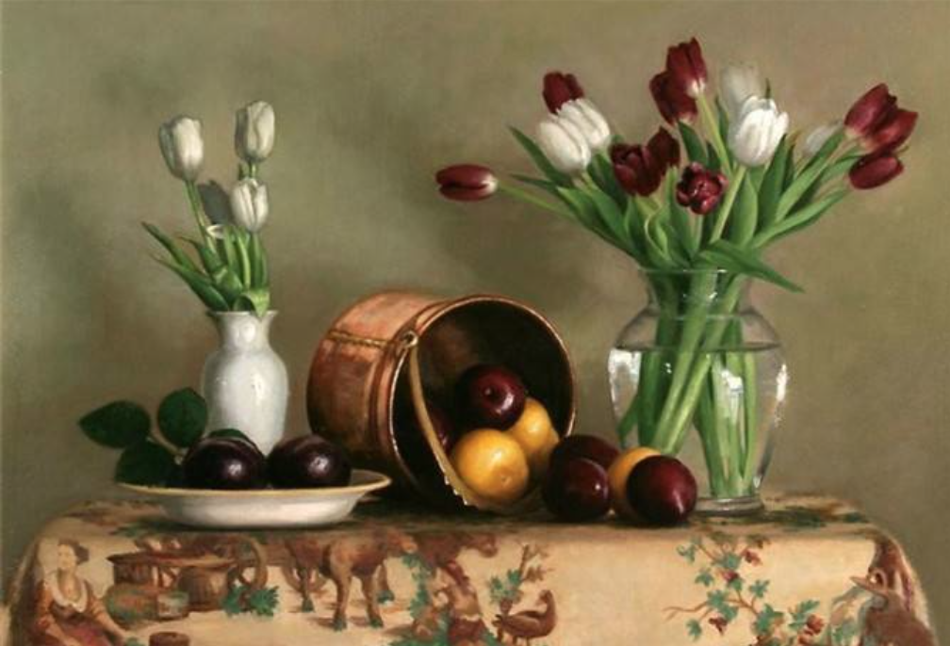

art 精讲精练：
TPO52 -lecture1 still-life painting
dynamic
vibrancy 活力
straightforward
simplicity
foreground
field guide 野外指南
composition 构图
deliberately
sketch 素描
cluttered 混乱的
contrived 人为的
positive space 、negative space

Slide 40
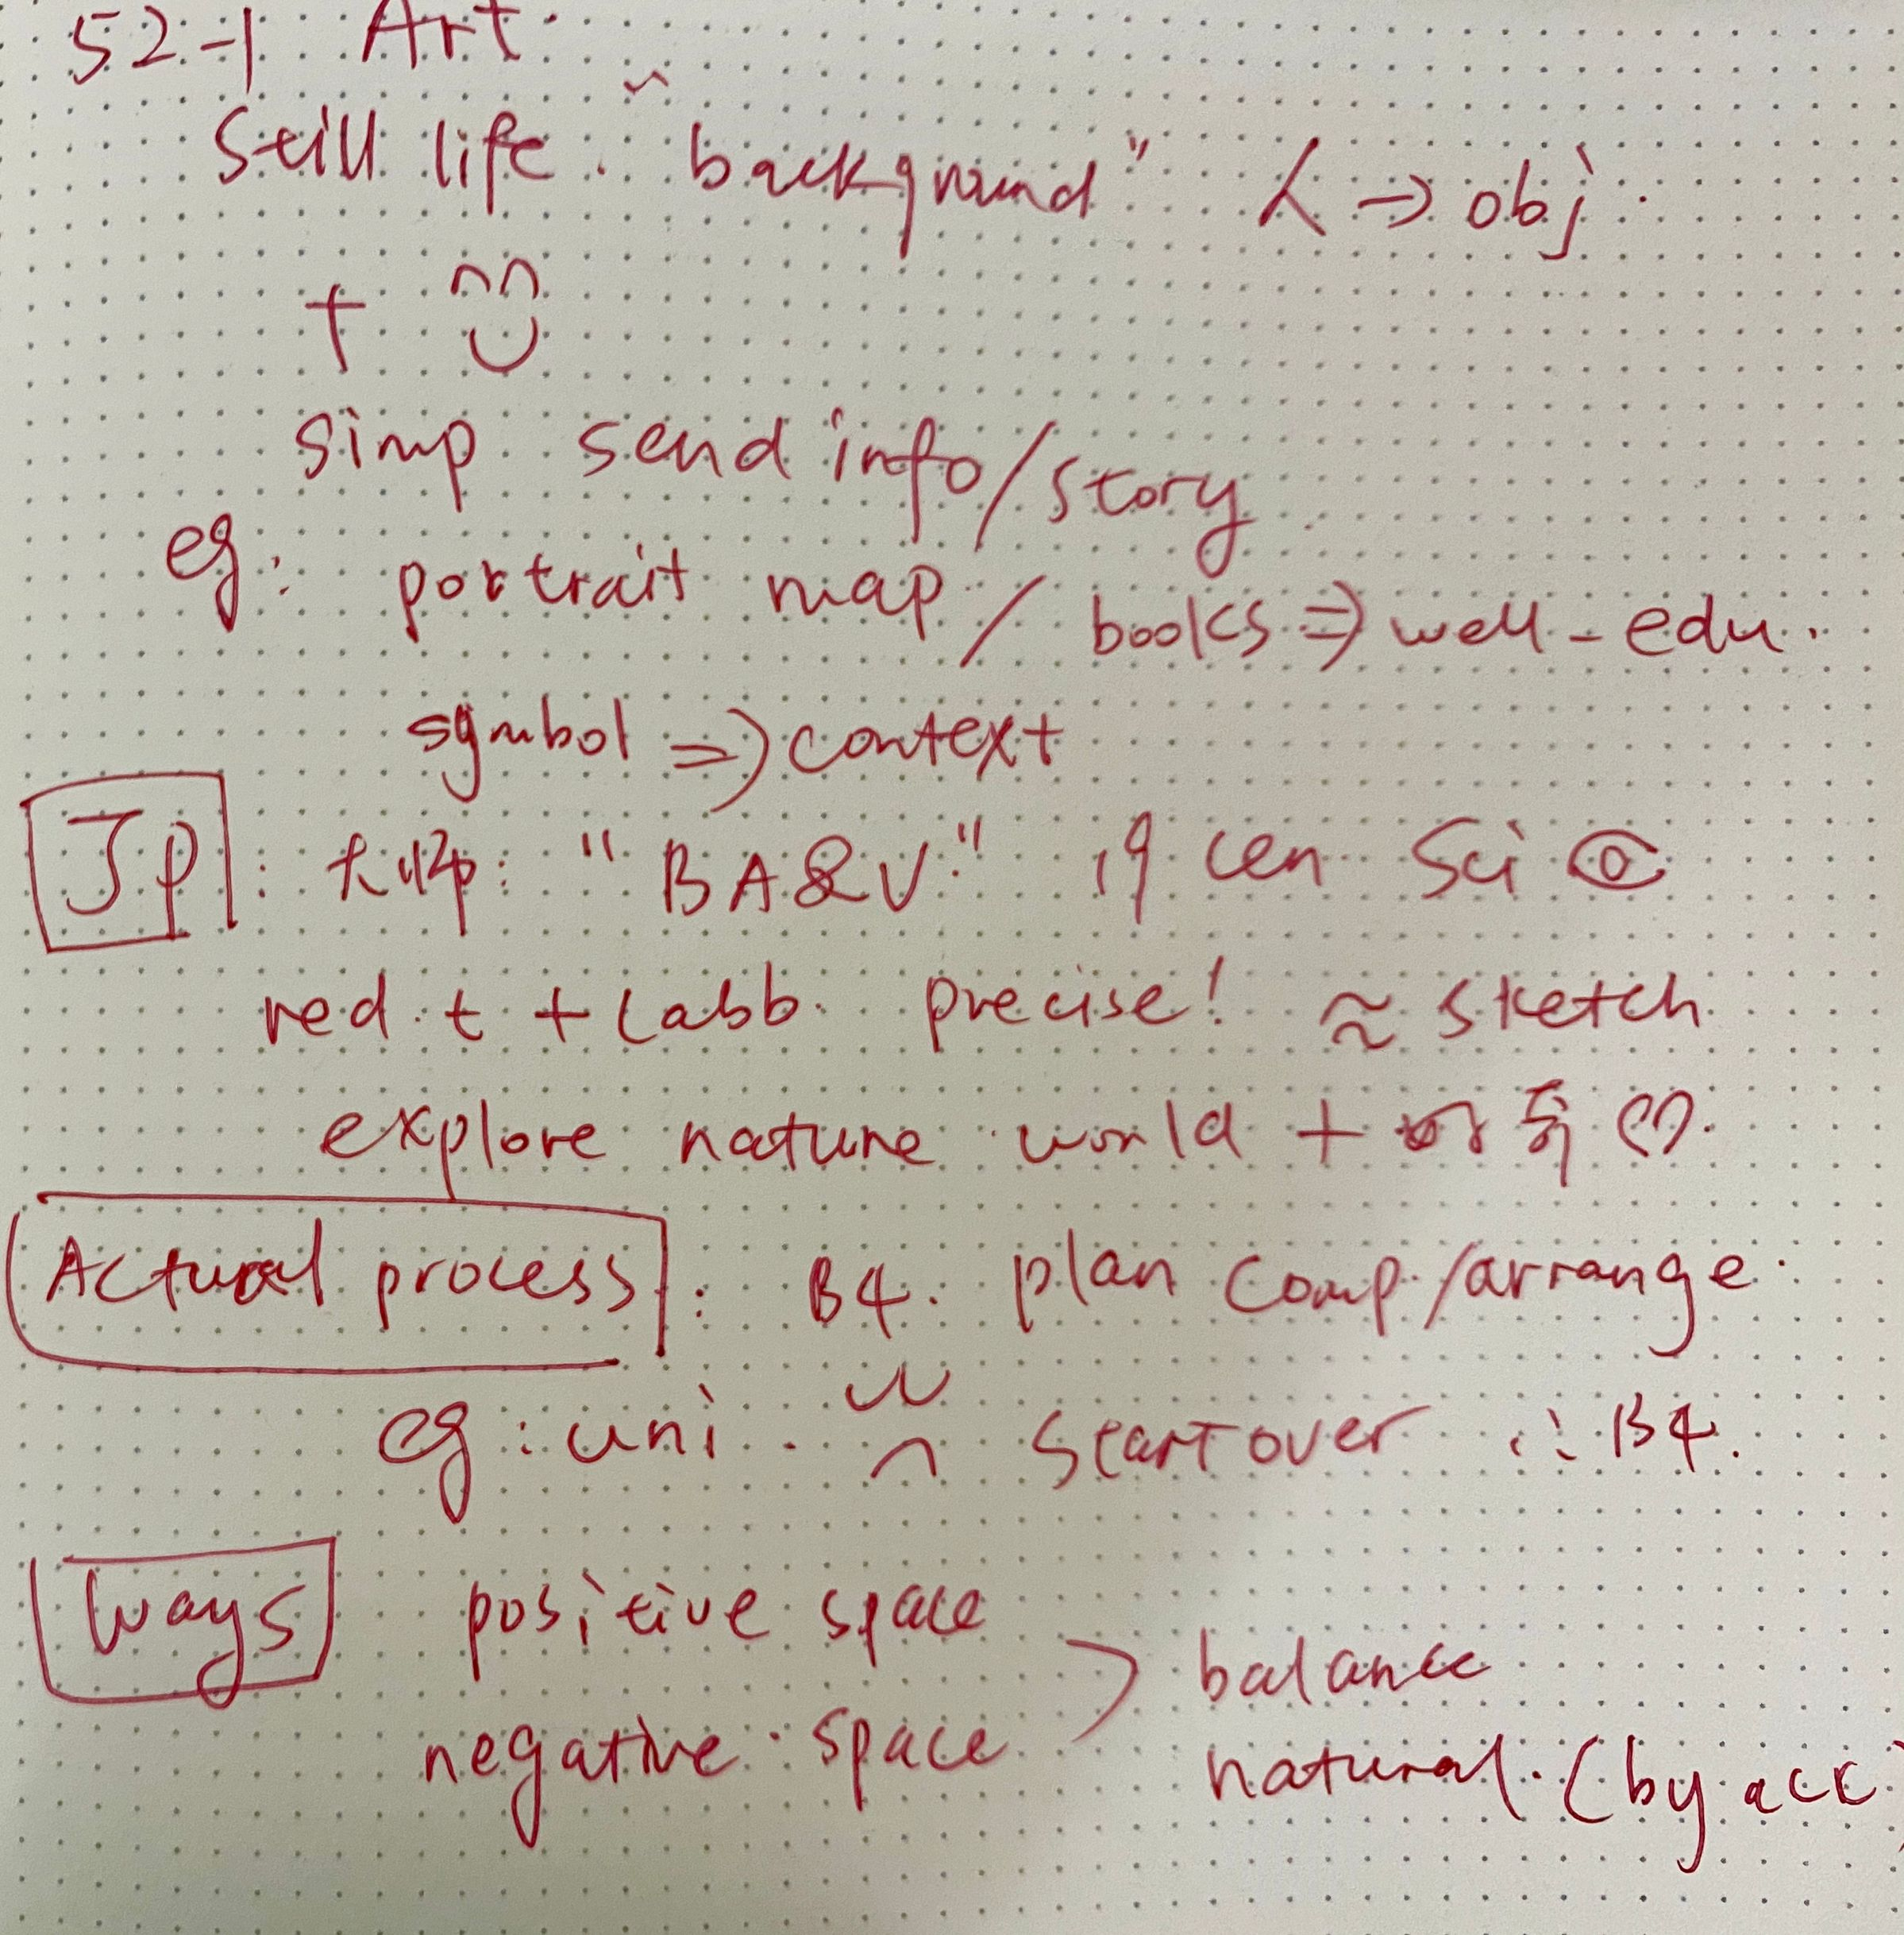
TPO52
lecture1
笔记

Slide 41
TPO52-lecture1
1. What is the purpose of the lecture?
A. To review important concepts from a previous class
B. To provide some background for a painting the class will be discussing
C. To compare two styles of painting
D. To prepare students for an upcoming project

Slide 42
TPO52-lecture1
2. Why does the professor mention books and a map?
A. To give examples of objects that are not typically used in still-life paintings
B. To give examples of elements of still-life paintings used in other genres of painting
C. To explain what inspired him to create a still-life painting at university
D. To explain why still-life paintings are often studied in beginning art classes

Slide 43
TPO52-lecture1
3. According to the professor, why did artists like James Peale adopt a scientific approach to still-life painting?
A. Their paintings were used to illustrate scientific journals.
B. They had studied science at university before becoming artists.
C. They were interested in exploring the natural world through their art.
D. They were interested in experimenting with nuances of color.

Slide 44
TPO52-lecture1
4. Why does the professor tell the story about his own painting of some vegetables?
A. To emphasize the importance of planning the composition of a still-life painting
B. To encourage the use of a variety of objects in a still-life painting
C. To capture the attention of students who are not interested in still-life paintings
D. To reassure the students that still-life paintings are not difficult to execute

Slide 45
TPO52-lecture1
5. What point does the professor make about negative space in still-life paintings?
A. It is overused in many still-life paintings.
B. It contributes to the balance in the composition of a still-life painting.
C. It often causes still-life paintings to look deliberately planned.
D. It may detract from the simplicity of the composition of a still-life painting.

Slide 46
TPO52-lecture1
6. Why does the professor say this:
A. To clarify the first step of painting a still life
B. To explain why he decided to become a still-life artist
C. To introduce a painting he is going to describe
D. To convince students that painting a still life can be rewarding

Slide 47
托福听力拔高班6
金牌听力名师
大菁儿老师
2021.7.2

Slide 48
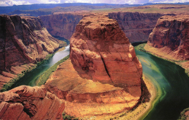
geology精讲精练：
TPO1 -lecture2 uranium-lead dating
Grand canyon 大峡谷
sandstone
radioactive
zircon grain 锆石
molten magma 熔化的 岩浆
lava
granite 花岗岩
conclusively 决定性地

Slide 49
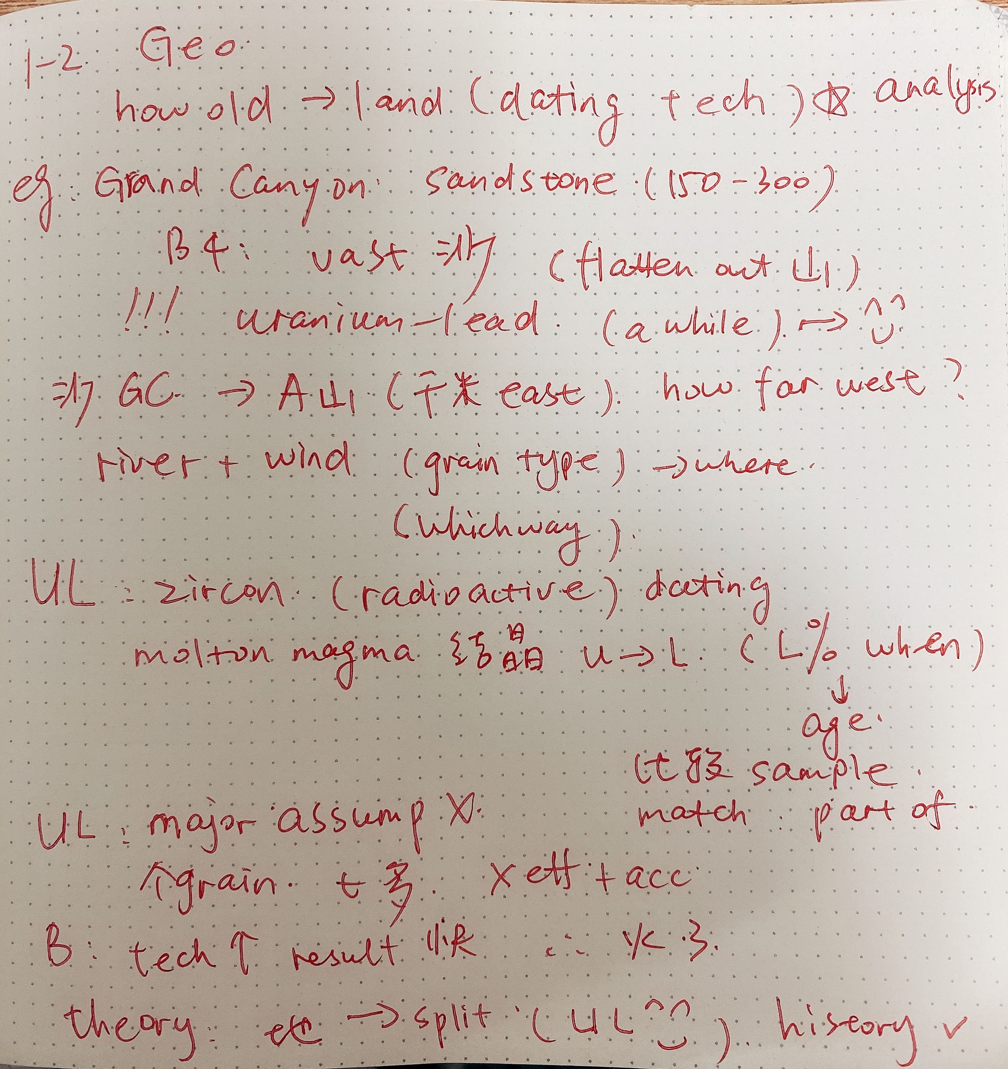
TPO1
lecture2
笔记

Slide 50
TPO1-lecture2
1. What does the professor mainly discuss?
A. The differences in age among American mountain ranges
B. The importance of a technique used for dating geological materials
C. The recent discovery of an ancient canyon
D. A comparison of various minerals used for dating

Slide 51
TPO1-lecture2
2. Before the use of uranium-lead analysis, where did most geologists think the Grand Canyon sandstone came from?
A. An ancient lake located in the American Southwest
B. A desert that once connected two continents
C. Sands carried by a river from the Appalachian Mountains
D. A nearby mountain range that had flattened out over time

Slide 52
TPO1-lecture2
3. In the talk, the professor describes the sequence of uranium-lead dating. Summarize the sequence by putting the events in the correct order.
A.Zircon in the sandstone is matched to the zircon in a particular mountain range
B.The amount of lead in sandstone zircon is measured.
C.The age of zircon in a sandstone sample is determined.

Slide 53
TPO1-lecture2
4. According to the professor, what change has caused uranium-lead dating to gain popularity recently?
A. It can be performed outside a laboratory.
B. It can now be done more efficiently.
C. It no longer involves radioactive elements.
D. It can be used in fields other than geology.

Slide 54
TPO1-lecture2
5. Why does the professor talk about the breaking apart of Earth's continents?
A. To give another example of how uranium-lead dating might be useful
B. To explain how the Grand Canyon was formed
C. To demonstrate how difficult uranium-lead dating is
D. To disprove a theory about the age of Earth's first mountain ranges

Slide 55
TPO1-lecture2
6. What does the professor imply when he says this:
A. The class is easier than other geology classes
B. The class has already studied the information he is discussing
C. Some students should take a course in geological dating techniques
D. He will discuss the topic later in the class

Slide 56
End

